Slide 1
Samarth SoochnaPreneur

Slide 2
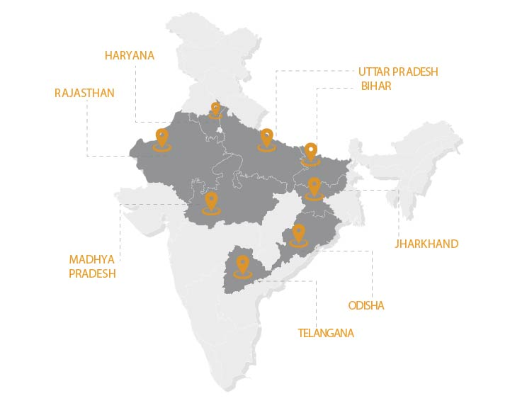
Geographical Presence
8 States, 10 District
States | Districts
Bihar | West Champaran
Haryana | Nuh
Jharkhand | Ranchi
Madhya Pradesh | Guna
Odisha | Bargarh
Rajasthan | Alwar, Barmer
Uttar Pradesh | Barabanki
Telangana | Wanaparthy, Nalgonda

Slide 3
Activities in Progress
Identification - 100 SSPs identified
Orientation and Immersion: Exposure to DEF’s run digital centres and first hand experience of centre operations
Centre Inauguration: Creating awareness in community about the services to be provided through centres
Awareness Camps around Scheme: Camps around Aadhar card, Ujjawala Yojana, Artisan card, Health card, Mudra Loan etc.
Regular handholding support to Samarth SoochnaPreneurs
Developed MeraApp scheme repository
Refresher training on MeraApp
Community awareness around Covid-19 preventions & safety
Digital literacy & STEM centers for community
Digital skilling of entrepreneurs through SSPs.
Notes:
Comments-Put the number under Developing MeraApp scheme repository

Slide 4
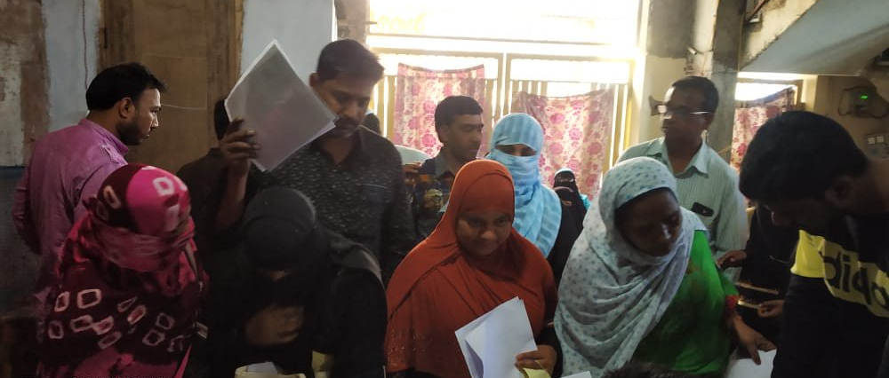
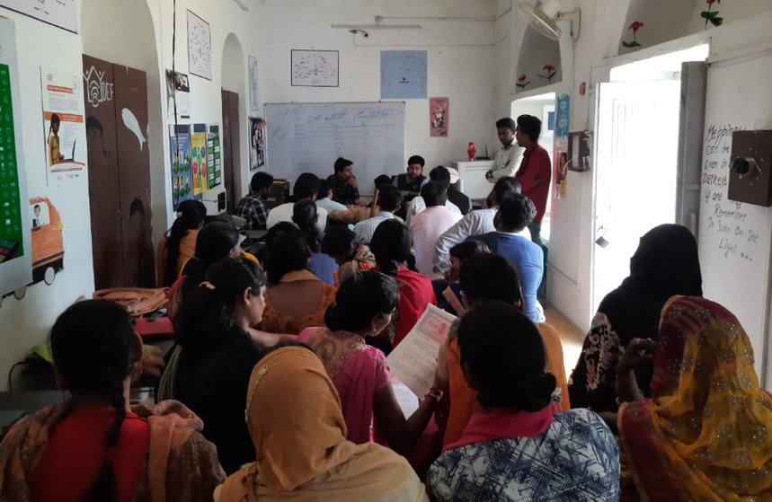
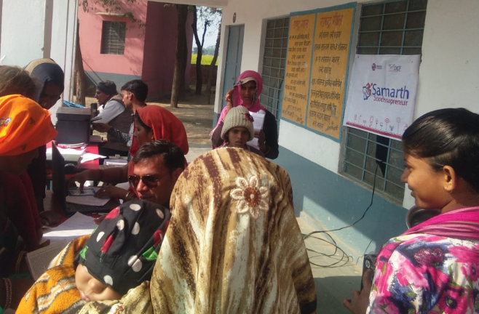
Awareness Camps around
February 2020, Camp around Aadhar Card held in Alwar, Rajasthan
February 2020,
November 2019, Barabanki, Uttar Pradesh
January 2020,
Notes:
Comments-Add Some more photos

Slide 5
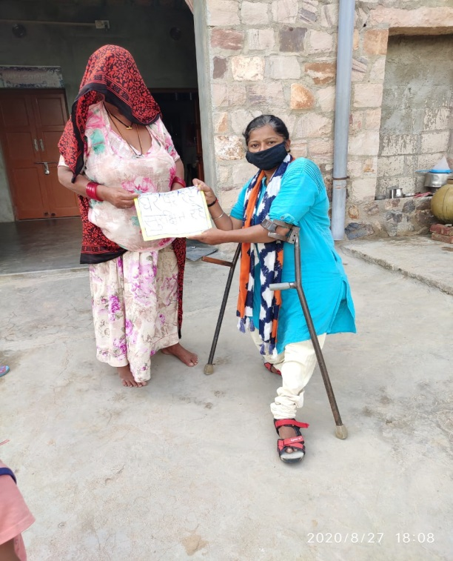
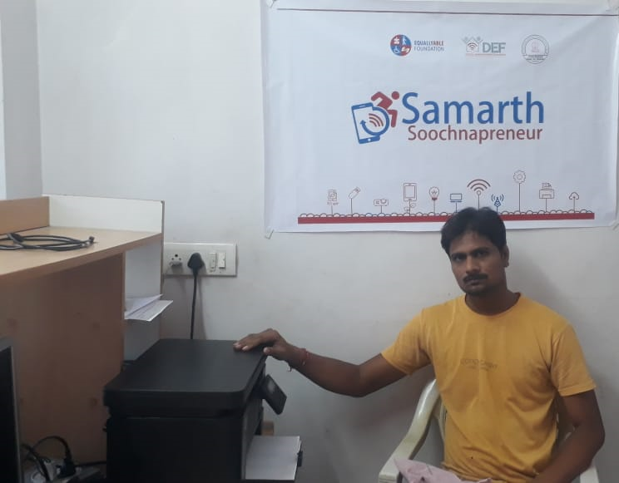
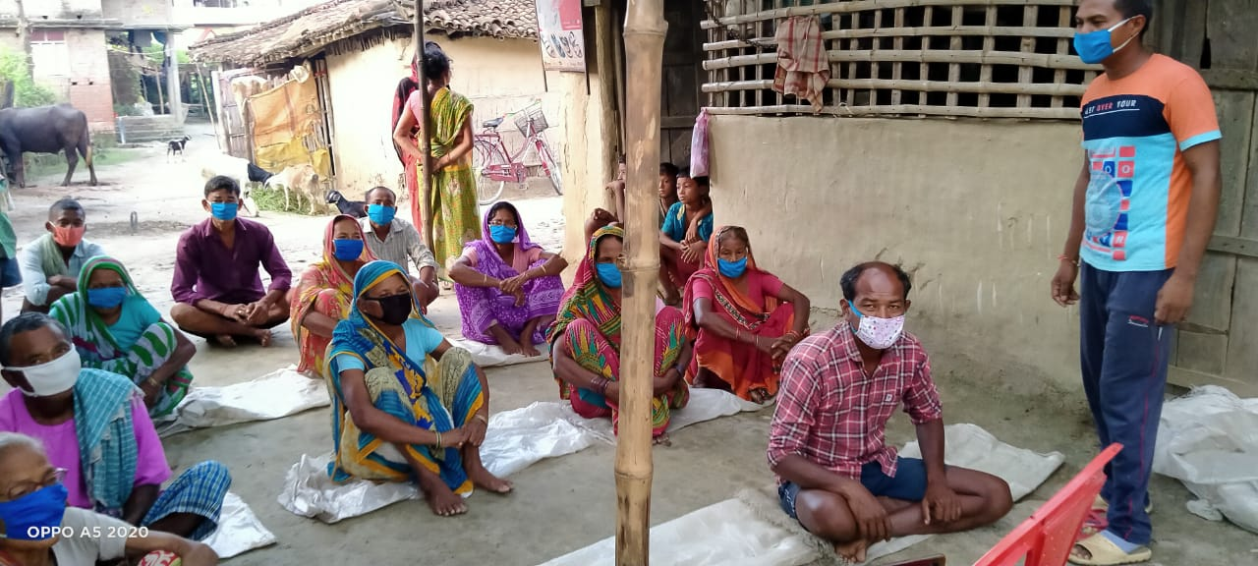
Regular handholding support to Samarth SoochnaPreneurs
SSP – Achlaram, Barmer - Rajasthan
SSP – Khushiram, Alwar - Rajasthan
SSP – Pappu Kanwar, Barmer - Rajasthan
SSP – Rehan, Barabanki, Uttar Pradesh
SSP – Chandan, Guna, Madhya Pradesh
Notes:
Comments- Add some more photo

Slide 6
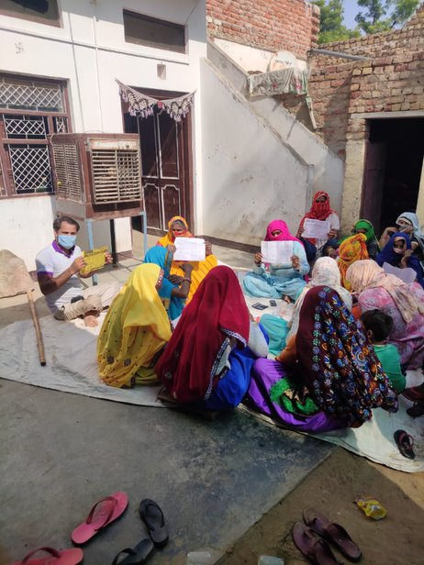
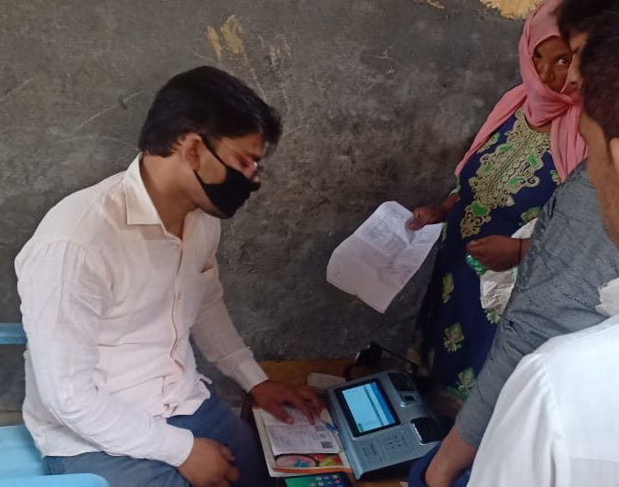
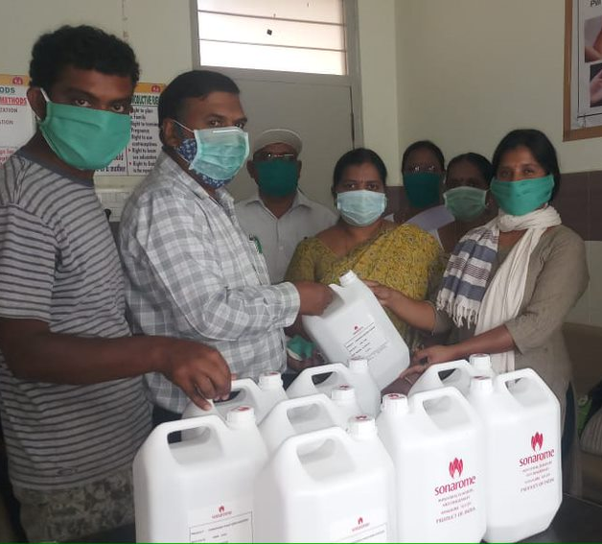
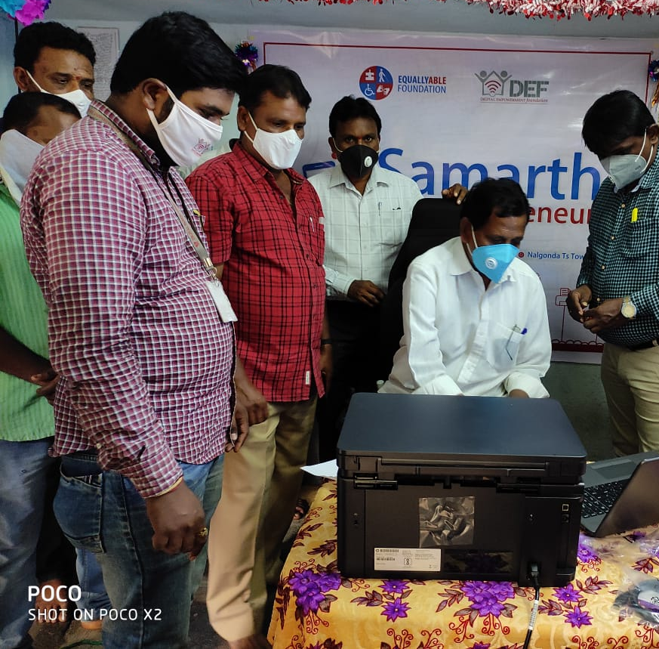
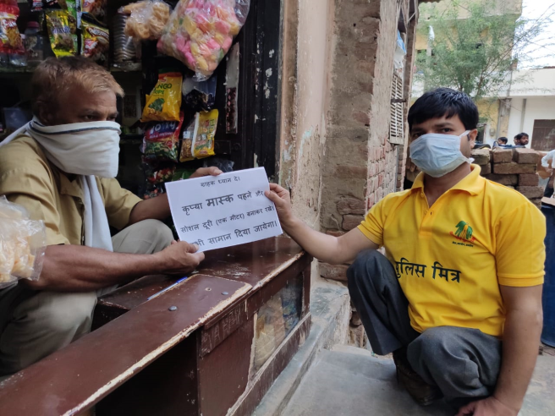
Community awareness around covid-19 preventions & safety
June 2020, Alwar, Rajasthan
June, Barmer, Rajasthan
Community meeting around covid-19 awareness
April 2020, Wanaparthy, Telangana
July 2020, Nalgonda, Telangana
June 2020, Awareness against covid

Slide 7
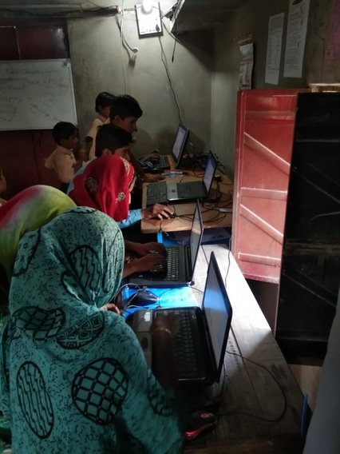
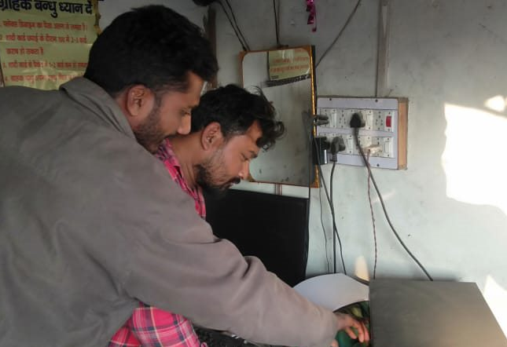
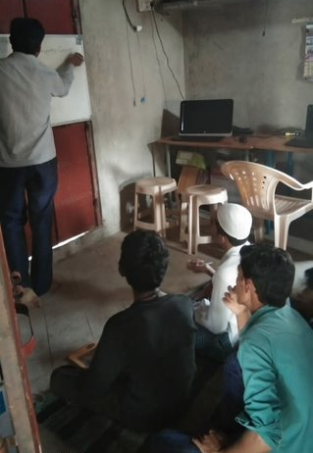
Creating digital literacy centers for community
West Champaran, Bihar
December, 2019, Nuh Haryana
November 2019, Alwar, Rajasthan
January 2020, Ramgarh, Jharkhand

Slide 8
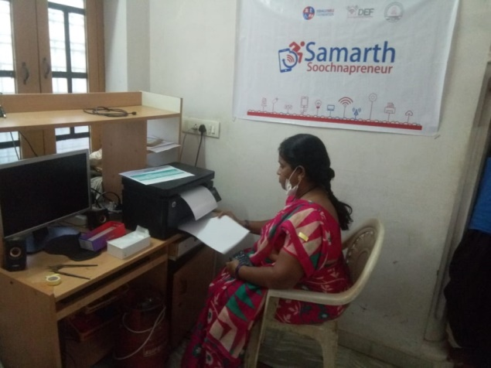
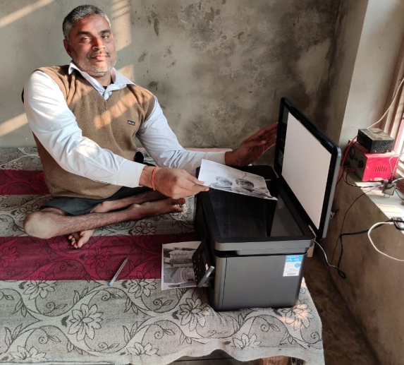
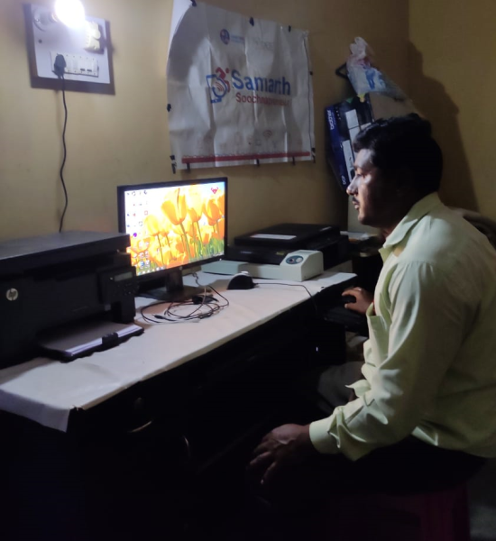
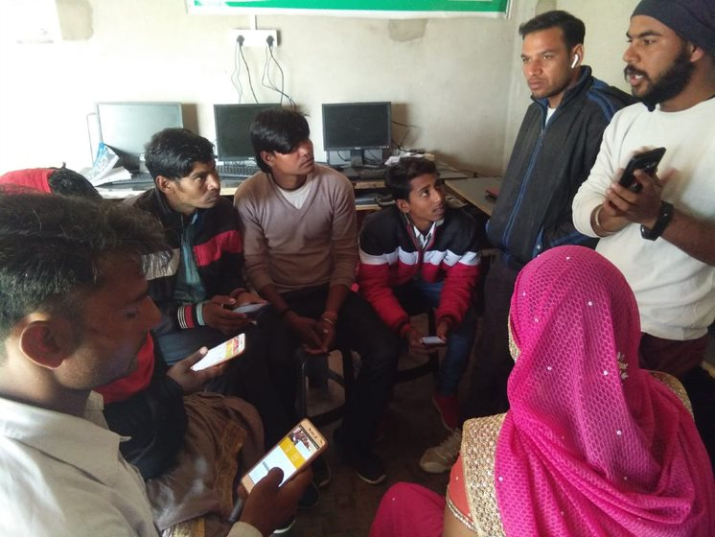
Digital skilling of entrepreneurs
Ranchi, Jharkhand
Guna, Madhya Pradesh
West Champaran, Bihar
Wanaparthy Telangana
Alwar, Rajasthan

Slide 9
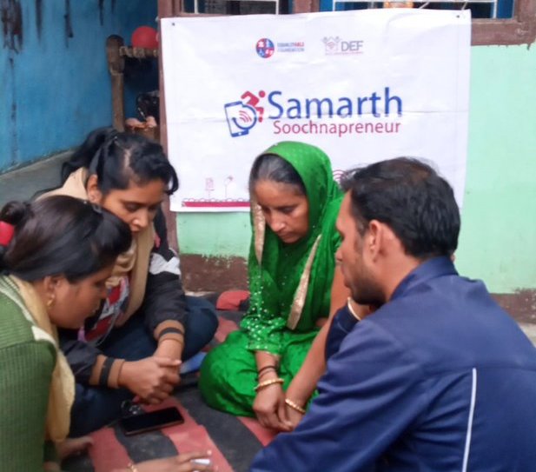
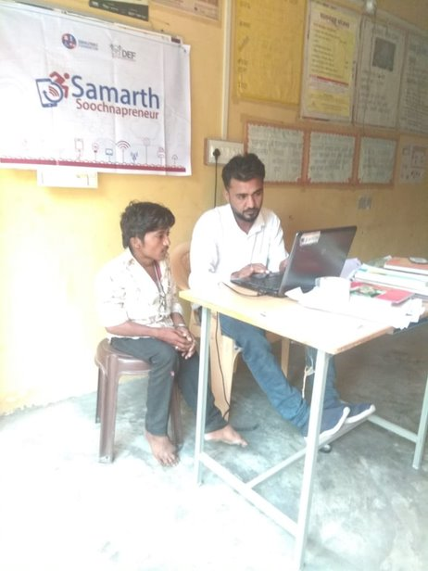
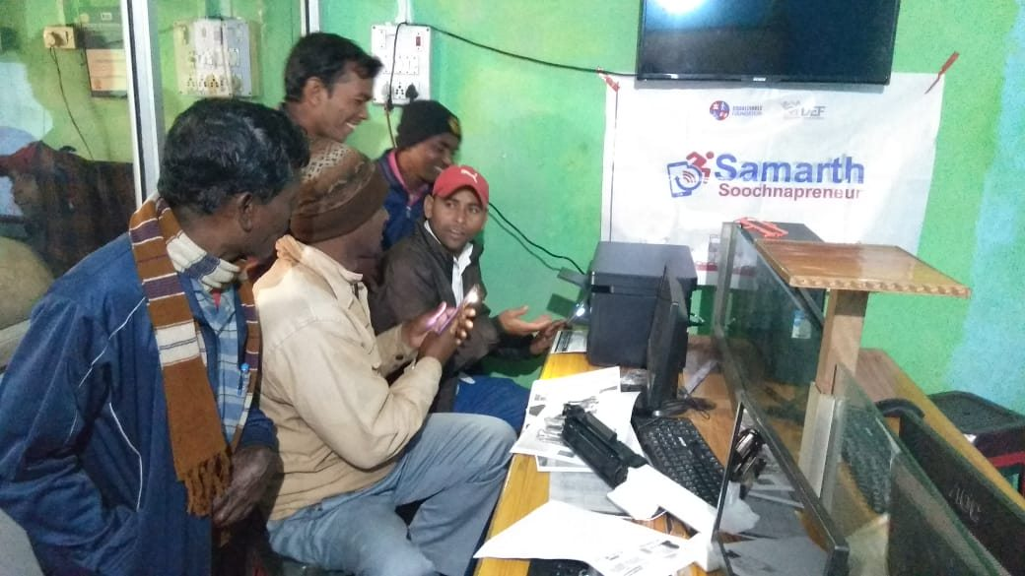
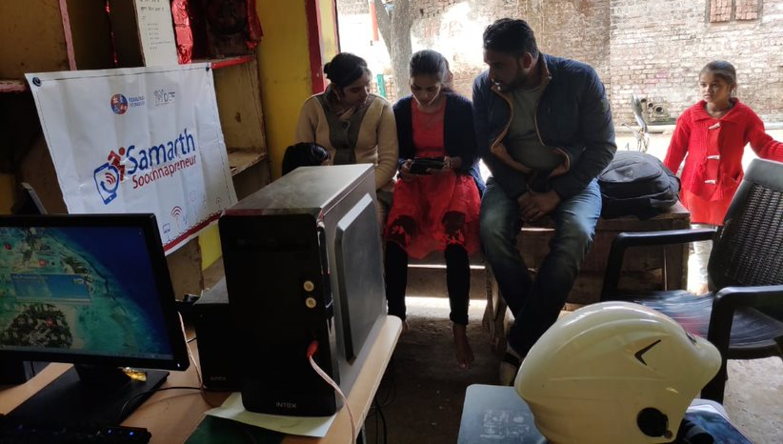
Trainings conducted under the program
Refresher Training, July, 2020 – Wanaparthy, Telangana
November 2019, MeraApp Training held by District coordinator, Alwar - Rajasthan
November 2019, Training held by District coordinator, Barmer- Rajasthan
December 2019, Training held by District Coordinator,Guna – Madhya Pradesh
December 2019, Training held by center coordinators, Gola - Ranchi

Slide 10
District-wise Active centers
S.no | State | District | Active Samarth SoochnaPreneur centers | Number of Male | Number of Female
1. | Bihar | West Champaran | 5
2. | Haryana | Nuh | 9
 |  | Palwal | 1
3. | Jharkhand | Ranchi | 5
 |  | Ramgarh | 5
4. | Madhya Pradesh | Guna | 10
5. | Odisha | Bargarh | 1
6. | Rajasthan | Alwar | 19
 |  | Barmer | 10
7. | Telangana | Wanaparthy | 16
8. | Uttar Pradesh | Barabanki | 10
 | Total |  | 91

Slide 11
District-wise Outreach, Scheme Linkage and Revenue details
S.no | State | District | No. of Registered beneficiary (Dec'19 - Oct'20) | No. of Linked Beneficiary (Dec'19 - Oct'20) | Revenue (Dec'19 – Aug’20)
1 | Bihar | West Champaran | 743 | 624 | 73465
2 | Haryana | Nuh | 269 | 231 | 52383
3 | Jharkhand | Ranchi | 243 | 111 | 39600
4 | Madhya Pradesh | Guna | 1985 | 1367 | 57373
5 | Odisha | Bargarh | 95 |  | 18000
6 | Rajasthan | Alwar | 1815 | 859 | 179252
7 |  | Barmer | 452 | 342 | 185710
8 | Uttar Pradesh | Barabanki | 1418 | 114 | 22100
9 | Telangana | Wanaparthy | 33 |  | 25720
 | Total |  | 7053 | 3648 | 601220
Notes:
Comment- Take out nuh Revenue detail from MeraApp back end service data

Slide 12
COVID-19 awareness and prevention
S.no | State | District | Information and Awareness | Outreach | Engagement
1 | Bihar | West Champaran | 5 | 10000 | 1700
2 | Jharkhand | Ranchi | 5 | 10000 | 1700
 |  | Ramgarh | 5 | 10000 | 1700
3 | Madhya Pradesh | Guna | 7 | 14000 | 2380
4 | Odisha | Bargarh | 1 | 2000 | 340
5 | Rajasthan | Alwar | 10 | 20000 | 3400
6 |  | Barmer | 8 | 16000 | 2720
7 | Uttar Pradesh | Barabanki | 12 | 24000 | 4080
8 | Telangana | Wanaparthy | 9 | 18000 | 3060
 | Total |  | 62 | 124000 | 21080
Notes:
Comments- we can change the heading to COVID-19 awareness and prevention.

Slide 13
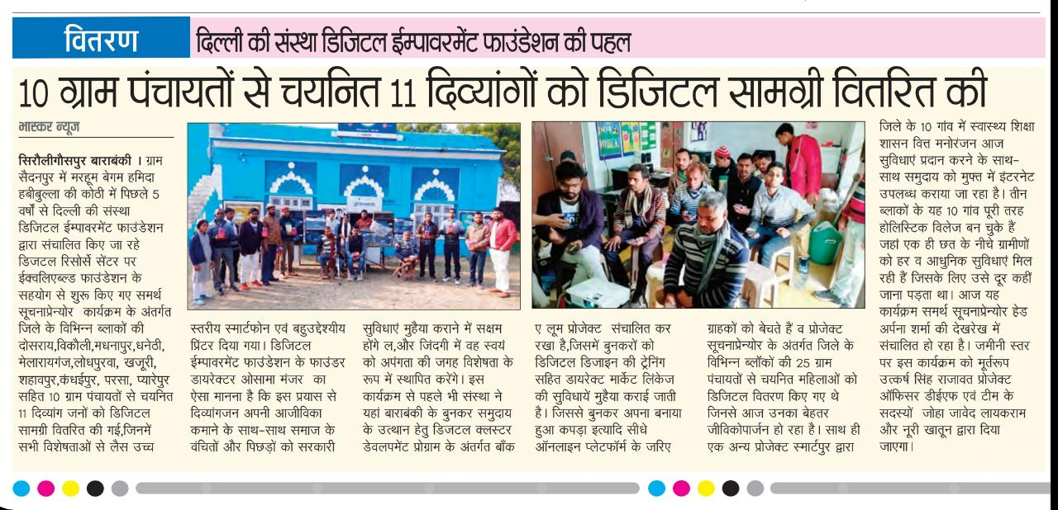
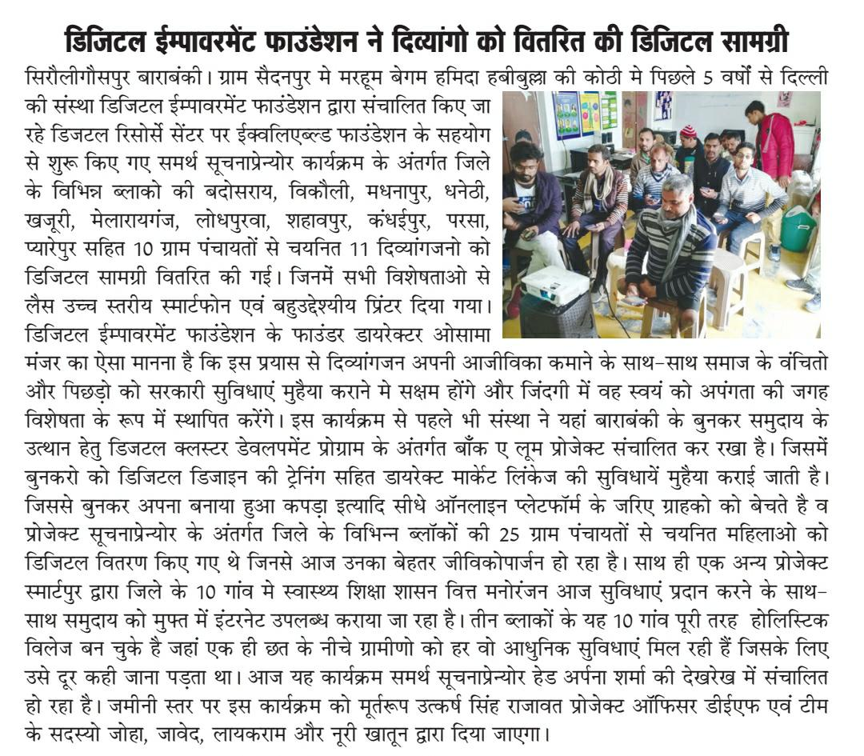
Annexure

